Slide 1
Pre-Calc & trig
Day 65

Slide 2
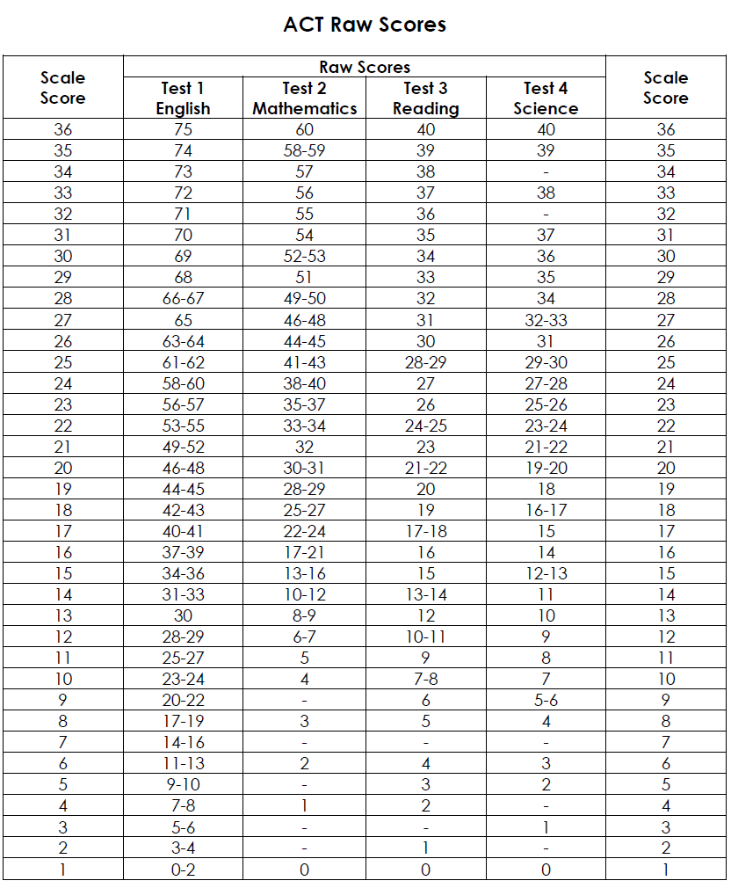

Slide 3
Reading
English
Science

Slide 4
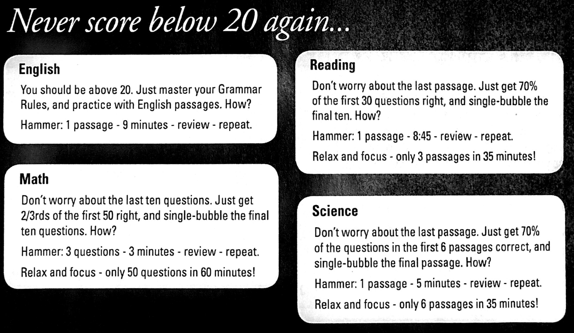

Slide 5
ACT DAY 5
Did you grade the full ACT test we took last time?
What questions do you have from the full ACT, the abbreviated ACT, and/or the mini ACT?
What general questions do you have about the ACT next week?

Slide 6
Collect all of your practice tests in one place… you should have the following:
2 - 4 mini tests (I’ll be looking for at least 2)
An abbreviated test
A full ACT booklet
We will be turning them all in at the start of next week

Slide 7
The last 10 – 20 minutes of class
You can work on previous Mini Tests (these will all count as your homework score for the semester and ultimately a formative quiz score based on completion and growth)
If you want another FULL ACT they are available.

